Slide 1
The AI Landscape &
Our place in it
Nader Afshar
04/02/2026

Slide 2
Agenda
AI Landscape : Core concepts: Neural Networks, NLP, RAG, Generative AI, Agents & MCP
Our Infrastructure: Cloud environments, observability, and AI-ready foundations
SFS Today: Current SaaS landscape and in-house AI capabilities
Current AI Posture: Recent Gap analysis findings and target state
Governance & Roadmap: Maturity model and tactical execution plan/progress
How we are applying it at SFS

Slide 3
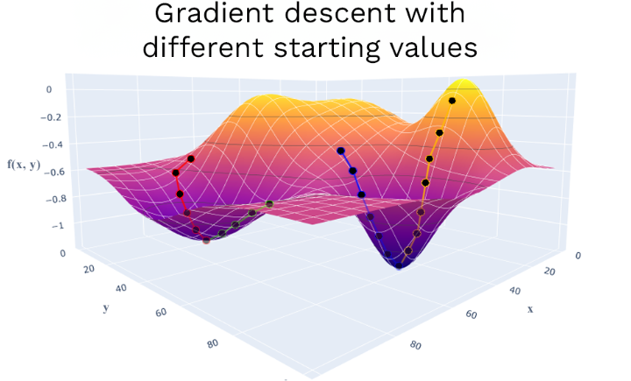
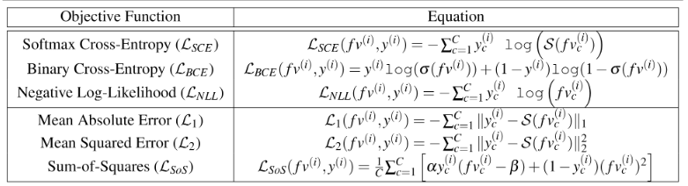
AI/ML is an Optimization Process
Optimization in AI/ML is the iterative process of adjusting model weights to minimize a loss function.
Gradients of the loss are computed via backpropagation, and an optimizer function uses those gradients to update the weights toward a “Global” minimum.

Slide 4
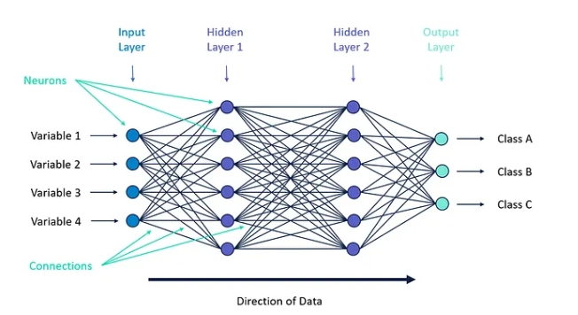


Neural Network
Modern AI is built on Neural Networks—mathematical models inspired by the human brain. They process data through "layers" of logic to find hidden patterns.
Architectural Complexity
Each neuron in the first hidden layer computes:
In Vector form:

Slide 5
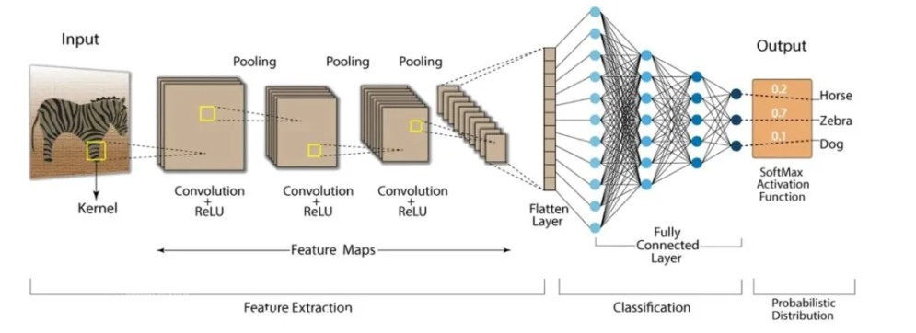
CNN: Convolutional Neural Network
Applications include:
Image Generation
Image analysis (X-rays, MRI, etc.)
Video Analysis & Generation
Manufacturing (identify defects)
Autonomous Driving
Auto Checkout
Visual Search
Face Recognition

Slide 6
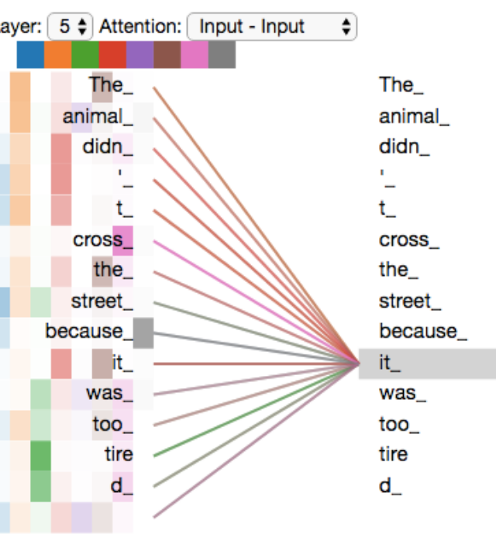
NLP – Natural Language Processing
NLP & THE "ATTENTION"
SHIFT
NLP allows computers to process human language. The major breakthrough was the Attention
Instead of reading word-by-word, the model looks at the whole sentence and "attends" to the most relevant words to understand context.
the difference between a "financial bank" and a "river bank."
Understanding Context

Slide 7
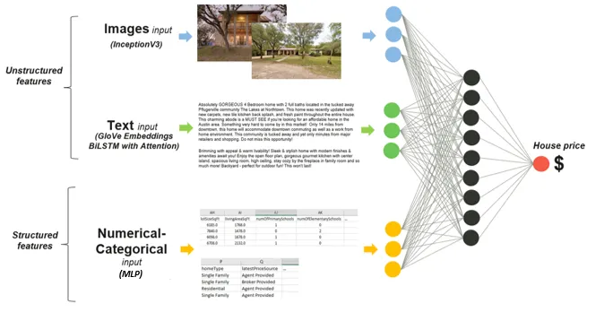
Multi-Modal Models

Slide 8
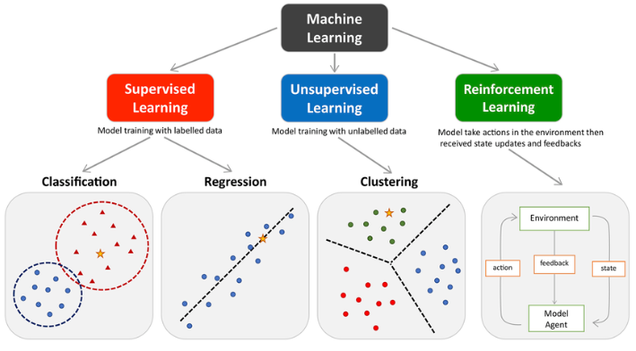
Classifications

Slide 9
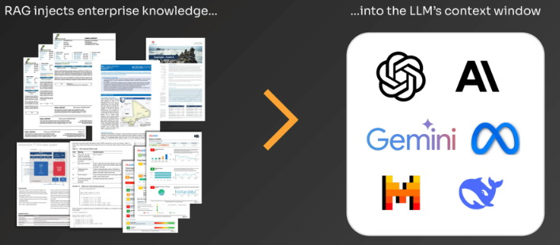
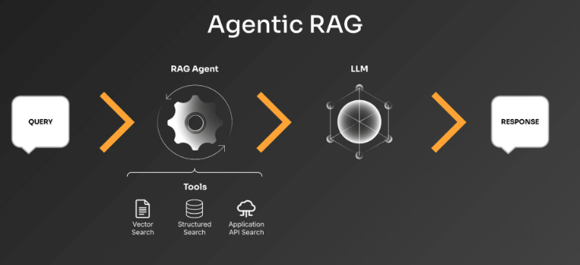
What is RAG

Slide 10
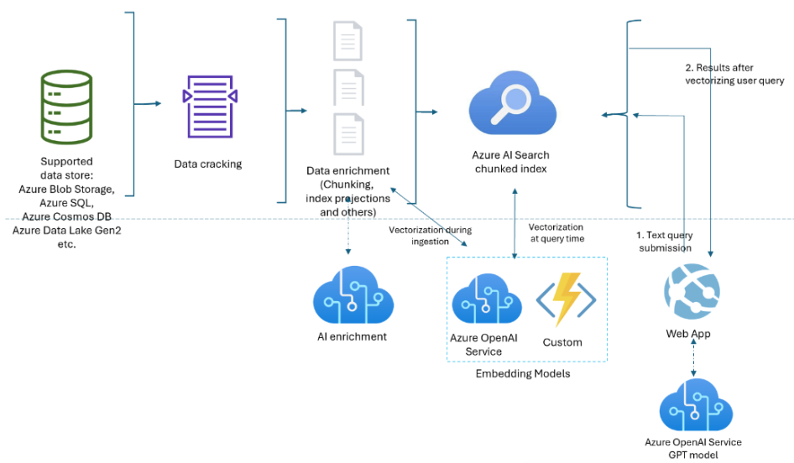


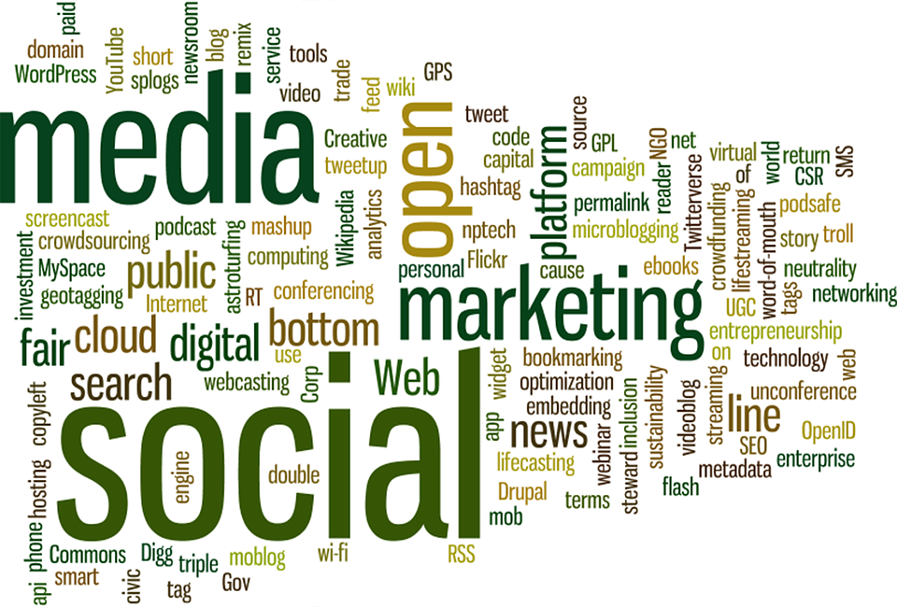

Multimodal Vectorization
Extract data from images

Slide 11

Generative AI (Text, Image & Video)
Generative techniques don't just sort data, they build it.
By learning the "rules" of art and physics, they create high-fidelity assets from a single prompt.
Beyond Analysis to Creation
Instant marketing assets and high-fidelity video.
Creating digital twins for urban planning or manufacturing.

Slide 12
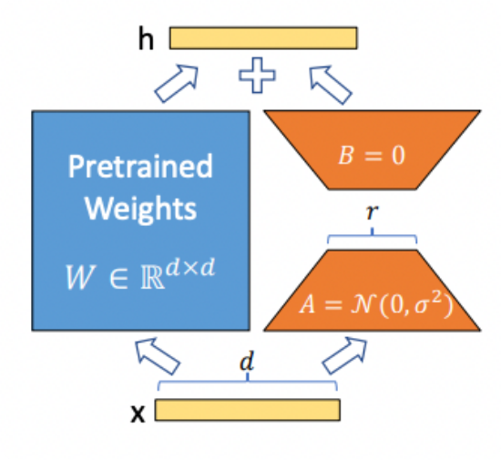

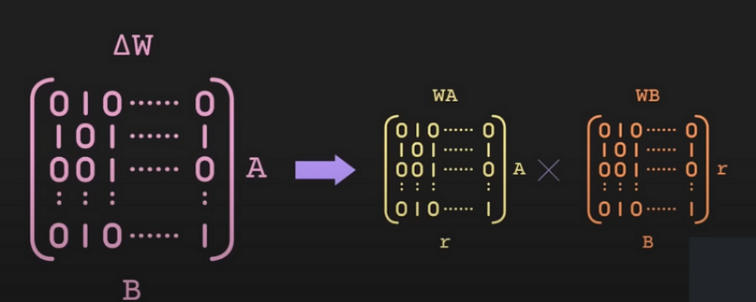
LoRA & QLoRA Fine Tuning
You don't need to rebuild an LLM to make it expert in your business. Simply add an adapter
The Efficiency Secret:
Quantization further compresses this math (4-bit data), allowing state-of-the-art models to be customized and served on computes as small as a single GPU.
Matrix decomposition changes the large AxB matrix into two smaller Axr & rxB so they can be multiplied far faster.

Slide 13

Age of Semantic Communication

Slide 14
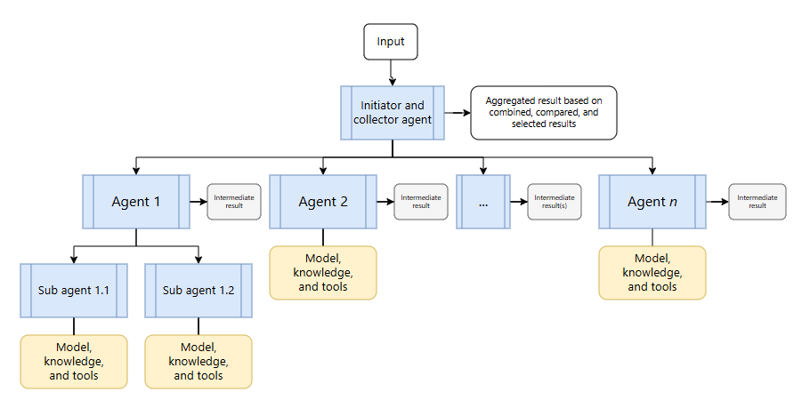
Orchestration of Agents
Orchestrated Agents
Business Case:
Orchestration based on existing business processes modeled in Nintex – Ryan Kerekes
Ref: https://tinyurl.com/2twd5ch4

Slide 15
The Integration Problem
TODAY — PROCEDURAL
"Get payoff balance
for account 123456"
Every SaaS connection requires deep technical knowledge –
and breaks whenever anything changes
SOQL: SF Object Language
▼ Developer must know:
✕ The exact REST endpoint & API version
✕ The OAuth 2.0 authentication flow
✕ SOQL query syntax
✕ Salesforce custom field names
✕ How to parse the response envelope
✕ Error handling & token refresh logic
Multiply this by every SaaS system you use

Slide 16
Future Integration Model - MCP
THE FUTURE OF ENTERPRISE INTEGRATION
Intent-driven agent communication
YOUR
AGENT
MCP SERVER
ENTERPRISE SYSTEMS & SAAS AGENTS
"Get payoff balance
for John Smith
account 123456,
return as JSON"
Sales_Force_Agent
Salesforce
SAP
Conduent
SAP_Agent
CRM agent
ERP agent
ITSM agent
Defi_Agentg
Workday
DEFI
RePay
No API knowledge
HR agent
Productivity
Intelligence
required
RePay_Agent
Auth · Logging · Key Vault
The human analogy —
When you call your bank and ask, "What is my payoff balance?" you don't know which system they check or who they ask. You express intent and receive a result. MCP brings this same natural model to enterprise software.
FROM
FROM
FROM
FROM
API endpoints & syntax
N × bespoke integrations
Breaks on API changes
Point-to-point coupling
↓
↓
↓
↓
TO
TO
TO
TO
Intent in plain language
1 × pattern for everything
Tool absorbs all changes
Composable agent ecosystem

Slide 17

Physical AI - Robotics
Legacy robots needed fixed lines;
Physical AI robots can "see" a messy warehouse, reason through the obstacle, and complete the task with human-like dexterity.
Digital Mind, Physical Body

Slide 18
Infrastructure

Slide 19
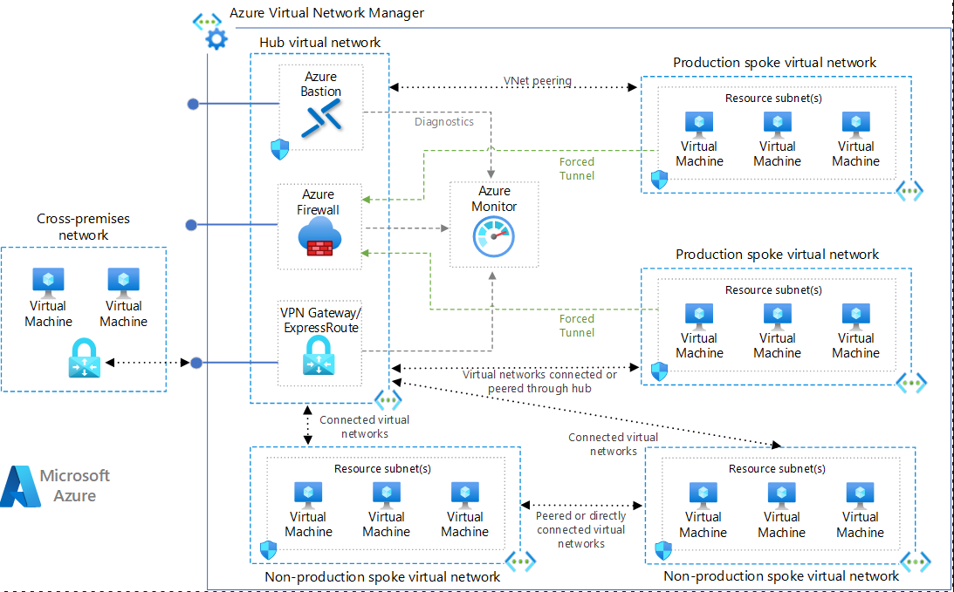
Isolated Cloud Environments (Dev/Test/Prod)
Bastian – Remote Desktop Protocol / SSH
Azure Monitor: Performance, Visibility, Alerts, etc.
Non-Prod : Only available in Dev/Test VNets.
VNet Peering – Connects VNets over Azure backbone.
Forced Tunnel – Forced Routing Configuration (UDRs)
UDR – User Defined Routing
Peered connection – Direct access. No Gateway required
VPN Gateway - Encrypts data in transit and allows secure remote access for employees.
Production VNet
Dev/Test VNet

Slide 20



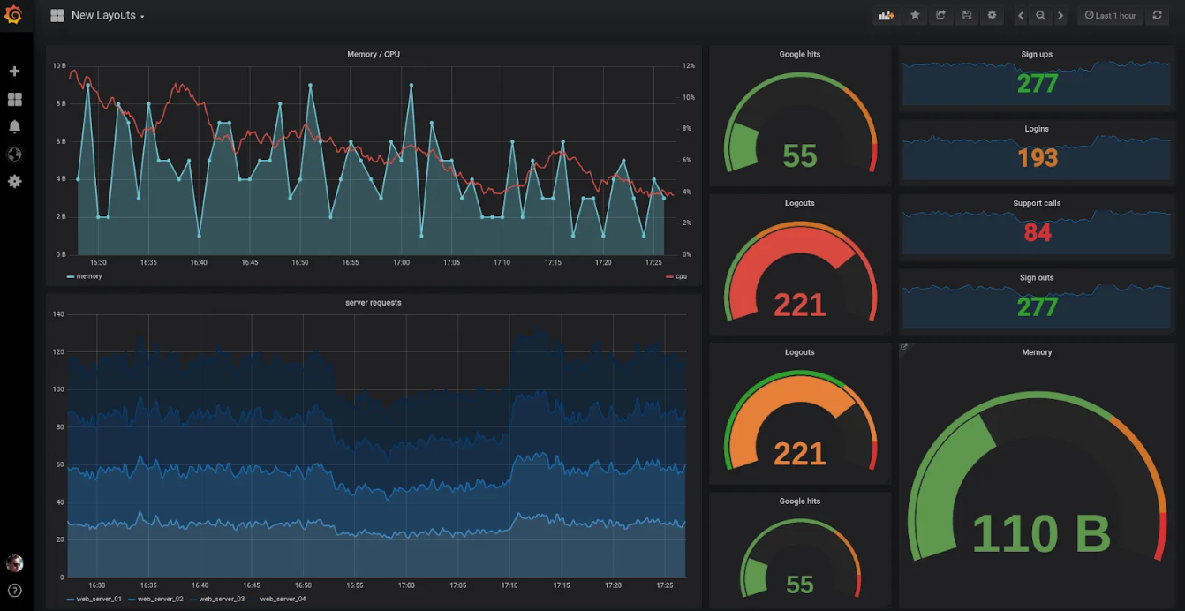
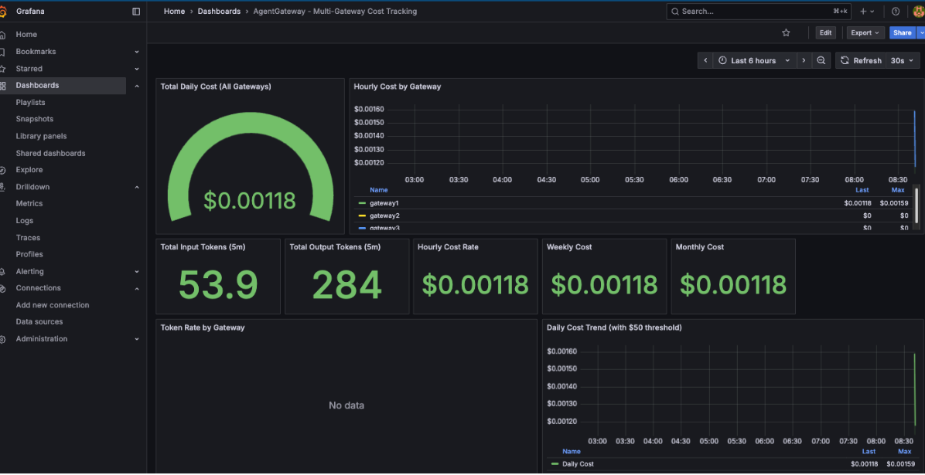
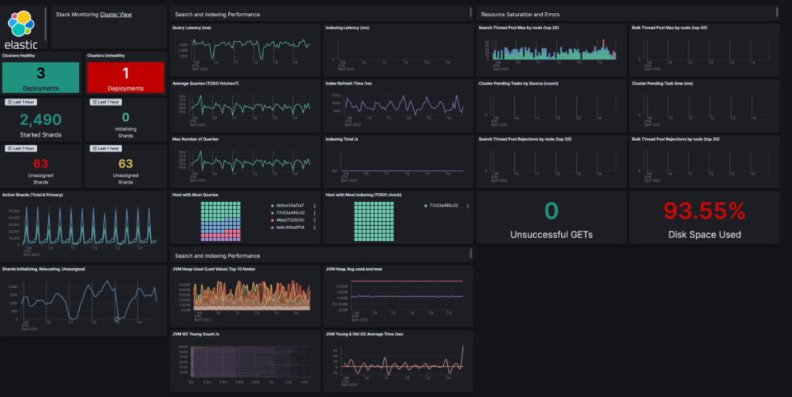
Full-Stack Observability
Prometheus
Grafana
ELK / Azure Monitor
Metrics: Real-Time time-series data for infrastructure health and AI system Latency
Visualization: Unified dashboards monitoring metrics, traces, and AI Token Spend
Elastic Search (ELK) on Azure for vast uses of search, including Logs & Traces for deep root-cause analysis.
Approved
TBD
Approved

Slide 21
AI Rollout at SFS

Slide 22




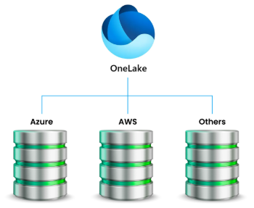










Current SaaS Environment
Genesys Cloud CX
TBD
Nightly update
Defi
Shaw
Concur
FICO
F&P
Informed
Repay
Conduent
ObserveAI
Mandrill
RDN
Dealtrack
Genesys & Sales Force do not have access to “all” data within the enterprise as such, and on a long-term basis, cannot form the backbone of our Enterprise-Grade Intelligence.
Crixp
DataScan
TKS
RG
Paycom
Concur

Slide 23
In-House AI Capabilities – Today and Target States
Today
Future
Predictive Models / ML
Residual Value Calculation
Logistics / Resale Value – Remarketing
Query Optimization
DB queries
BI queries
ObserveAI
Customer Sentiment Analysis
Copilot-style assistance
Others
InformedIQ
MS Copilot
RAG (Retrieval‑Augmented Generation)
Access to unstructured Enterprise Data
Enhance Information/Data Accuracy
Enhanced BI functionality (auto-gen reports)
Develop “DocumentAI” functionality
Agentic & Other Systems (In-House & Genesys)
Enhance Human-Agent efficiency
Enhance SDLC Process
Enhance Customer Experience
Prepare for Call Surge (50k/d -> 100k/d)
Introduce AI-Agents (Multi-lingual service)
Business Process Automation through Agent-Orchestration
Enhance H/R functions
Enhance Accounting & Finance functions

Slide 24
Gap Analysis
Earley Group analyzed our AI-Posture from both Governance and Capability Perspectives
Six Themes were considered:
Theme 1: Knowledge Architecture Foundation
Theme 2: Operational AI Enablement
Theme 3: Customer Experience Intelligence
Theme 4: Developer & Analyst Productivity
Theme 5: Data Platform Modernization
Theme 6: AI Governance Operationalization

Slide 25
15 Findings
Summary of our Gap Analysis
Enterprise Data Foundation Incomplete
AI Governance Gap / Shadow IT
Customer Service Highest ROI Opportunity
Testing Bottleneck
BI Productivity Constrained
Remarketing Lacks Intelligence
Conversational AI Lacks Rigor
Cross-System Integration Barriers
Document Intelligence Untapped
Portfolio Growth Needs Predictive Analytics
Knowledge Management Inadequate
Website/Digital Underperforms
Resource Allocation Lacks Prioritization
Process Maturity Gap
Competitive Positioning Needs Strategy

Slide 26

Governance Maturity Roadmap
Transformational
Complexity
Integrated
Defined
Emerging
Experimental
Early Pilots
No Formal Strategy
Few Guard Rails
Maturity

Slide 27
Governance Maturity Roadmap …
Transformational
Complexity
Integrated
Defined
Emerging
Initial AI Strategy
Select Use Cases
Basic Governance Guidelines
Experimental
Maturity

Slide 28
Governance Maturity Roadmap …
Transformational
Complexity
Integrated
Defined
Clearly Articulated Strategy tied to business Outcomes
Established Governance Policies & Standards
Emerging
Experimental
Maturity

Slide 29
Governance Maturity Roadmap …
Transformational
Complexity
Integrated
AI Woven into multiple Products, Services, and Decision-Making Processes
Robust Governance covering Data, Compliance & Biases.
Defined
Emerging
Experimental
Maturity

Slide 30
Governance Maturity Roadmap …
Transformational
AI Woven into Competitive Strategy, driving Market Strategy, Innovation & Differentiation
Mature Governance with proactive controls, dynamic guardrails, and ethical risk mitigation.
Complexity
Integrated
Defined
Emerging
Experimental
Maturity

Slide 31
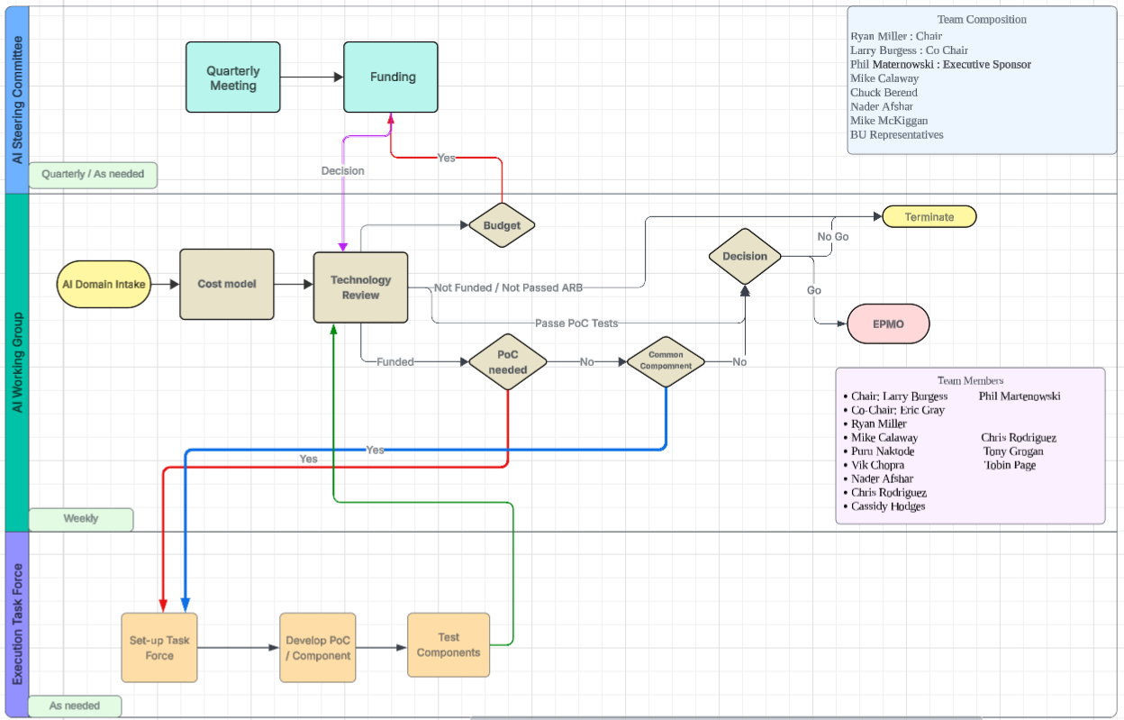
3-Tiered Governance Model

Slide 32
Governance Tactical Road Map
Q1/Q2: Experimental / Emerging
Level 2
Completed
Governance Criteria | Key Actions | Deliverables | Due Date
Operating Model and Oversight | Establish the AI Operational Working Group (AWG). | Ratify the Charter Ratify Key members Establish Intake Process Establish exit criteria Determine process for standing up Execution Task Force (ETF) Define Documentation Requirements | 02/27/2026
Financial, DevOps | Facilitate deployment of “Pricing Agent” from Risk Group Address Shadow IT Root Causes and eliminate all. | Short term budget for tokens CBA on Hugging Face to save on tokens Establish tools for all forms of AI uses & plan to make them available over the course of the year Define best platform for deployment of internal apps | 3/6/2026
Registry | Central Registry for Models & Tools | Plan for tagging all PII and related data CBA on SLM vs LLM, on premise Set-up an MCP for tools and Agent registry. A model registry will also be needed if we build our own. Begin discussion on consolidation of Genesys & Observe AI. | 3/13/2026
Financial | Genesys & Observe AI | Finalize the decision Plan the transition | 3/20/2026
Data Classification Data Lineage | Prepare data to be AI-Ready | Classify all Structured (90% currently untagged) Classify all Unstructured data (Nearly all untagged) Define framework for vectorization of all Unstructured data Setup a fund to implement RAG pipeline | 3/27/2026
Legal, Compliance & Regulatory Controls | Ensure Compliance with Regulatory Statutes. | Ensure encryption at rest and in transit. Maintain audit logs for all data access and changes. | 4/3/2026
End of Q2 - 2026 Target

Slide 33

Governance Tactical Road Map …
Q1/Q2: Experimental / Emerging
Level 2
Completed
Governance Criteria | Key Actions | Deliverables | Due Date
Financial | Cost Attribution | Assign each AI TCO to the sponsored BU. | 4/3/2026
Metadata Management | Ensure all structured Data have associated metadata | Assign retention, classification, or compliance policy to all data. | 4/3 - 4/24/2026
Vendor Management Policies & Engagement process | Establish a clear process for Tool evaluation and Vendor Engagement. | Vector Databases, Monitoring and logging tools, Model assessment tools, PII detection tools, Model Drift detection tools, etc. | 4/10 – 5/1/2026
Incident Response | AI incident response playbook | Processes & Tools to manage model failures, bias incidents, hallucinations, data leakage, and adversarial attacks. | 4/17 – 5/8/2026
DevSecOps | Establish Deployment Patters | Canary / Blue-Green deployment to limit blast radius. Rollback & Recovery Procedure. Shadow mode deployment (run along side legacy before cutover) | 5/15 – 5/29/2026
38% Completed in 30 days

Slide 34

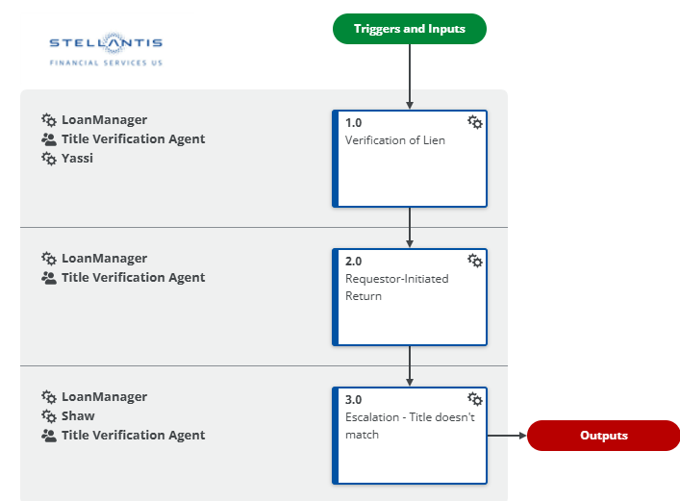
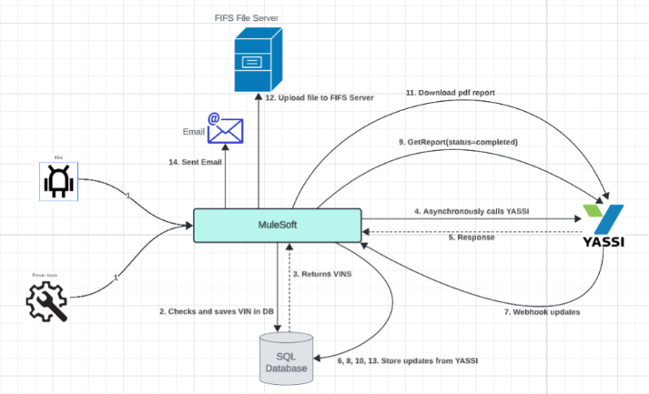
Existing SDLC Process
Process Flow
Nintex
& Policy Documents, etc.
1
High-Lebel Requirements Confluence
2
3
Architectural Design
Confluence
4
Detailed Requirements
5
7
6
UAT
Deployment
Sprints/Code

Slide 35


AI-Enhanced SDLC Process (Shift-Left)
1
High-Lebel Requirements Confluence
2
Process Flow
Nintex
3
Architectural Design
Confluence
4
Detailed Requirements
Confluence
Human Involvement
Claude Code Auto-Generation
Text
Image
Image
Text
AI-Enabled
5
Coding Standards
Architectural Standards
Deployment Standards
Security Standards
Regulatory Standards
Monitoring Instrumentations
Code
UAT
Deployment
Claude Skills

Slide 36
First Agentic Application
First AI Agent
Yu Luo & The team in Risk Management have rolled out a “Pricing Agent”. Soon to be available internally on MS Teams.
This application will also be made available to the Dealer community, likely via “Dealer Dash”
The application collects all incentives available for a given transaction and makes them visible to the dealer.

Slide 37
Appendix

Slide 38
What is MCP?
The Integration Problem
Every SaaS connection requires deep technical knowledge – and breaks whenever anything changes
TODAY — PROCEDURAL
TOMORROW — SEMANTIC INTENT
"Get payoff balance
for account 123456"
"Get payoff balance
for account 123456"
▼ Developer must know:
▼ Agent simply calls MCP:
✕ The exact REST endpoint & API version
MCP finds the right tool/Agent and calls it
✕ The OAuth 2.0 authentication flow
VS
▼ Receives clean result:
✕ SOQL query syntax
{
"name": "John Smith",
"account": "123456",
"payoff_balance": 42850.00
}
✕ Salesforce custom field names
✕ How to parse the response envelope
✕ Error handling & token refresh logic
Zero API knowledge required
Multiply this by every SaaS system you use
Same pattern works for every SaaS system

